Slide 1
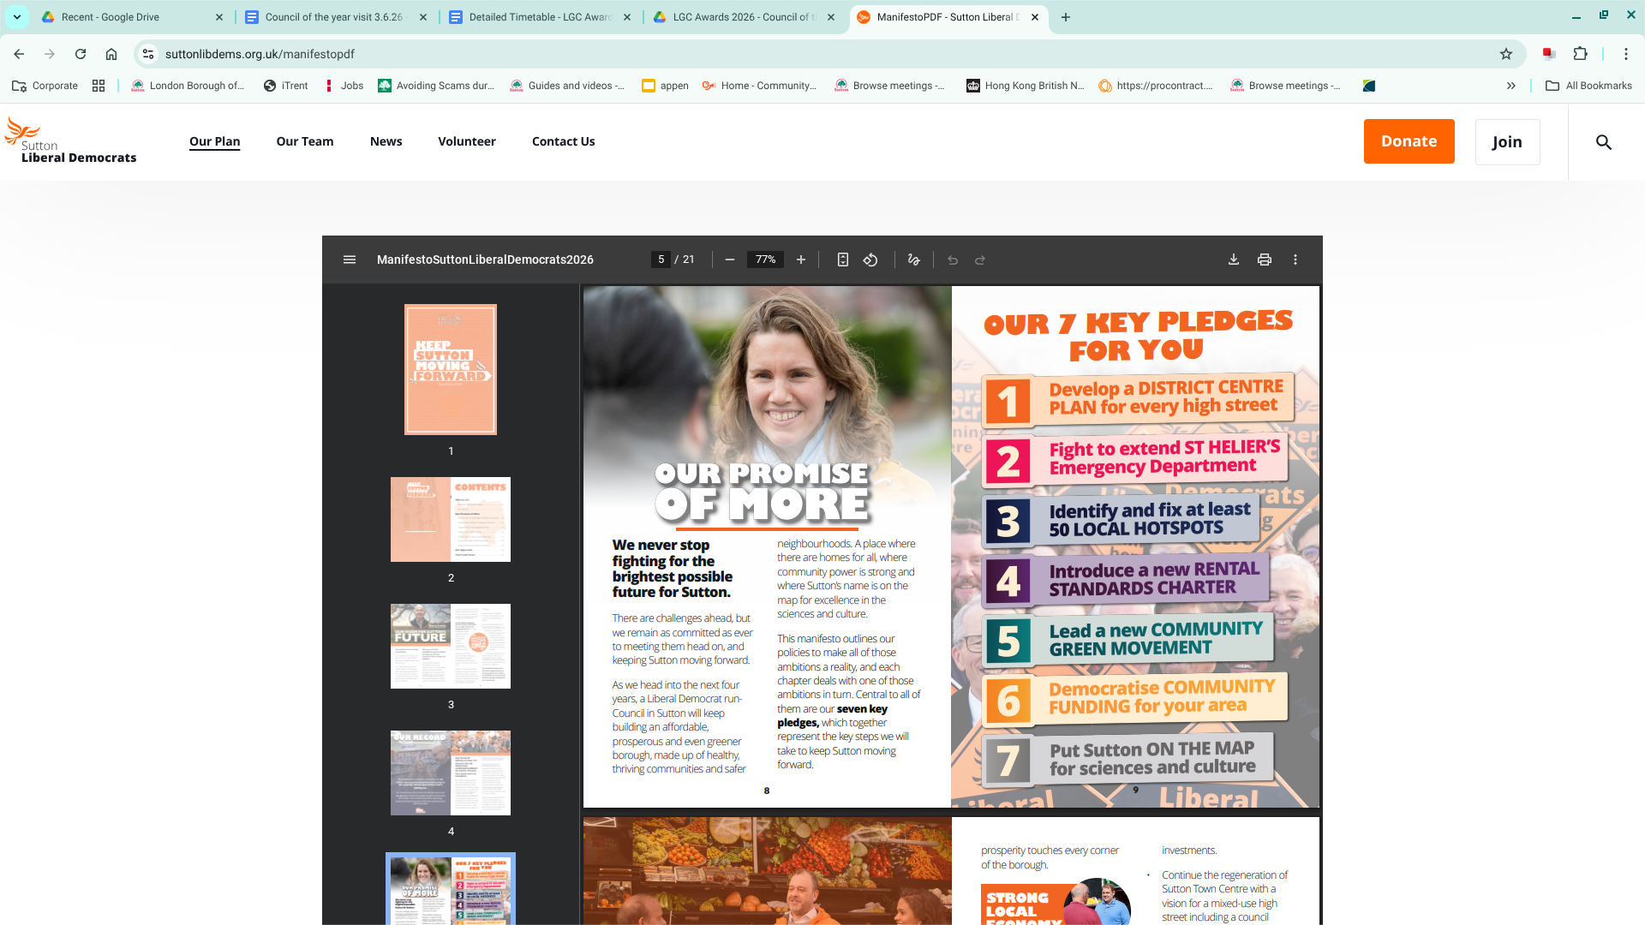
Manifesto
7 areas
An affordable, prosperous borough
Healthy, thriving communities
Safer neighbourhoods
Homes for all
An even greener borough
Build community power
Put Sutton on the map

Slide 2
Commitment to partnership
‘Work with the charity, community and faith sector (CCF) to explore the greater use of the sector in delivering our objectives, while in turn recognising and empowering their contribution.’
‘We will make sure all residents can play an even bigger role in making Sutton a great place to live, through community and civic participation. Sutton’s charity, faith and community sector will be key to this.’

Slide 3
Areas for collaboration
Supporting young people (including youth voice, more social and recreational opportunities and mental health and wellbeing)
Supporting and promoting care in the community for older people
Ensuring adults with Learning Disabilities get support to live independent lives
Cost of living support; helping those who are in need of help and support due to rising costs

Slide 4

Indicative timeline
June - Aug
Oct S&R
Feb S&R
Engagement to develop the manifesto into a new corporate plan
Outline plan taken to S&R committee
Final plan taken to S&R committee

